Slide 1
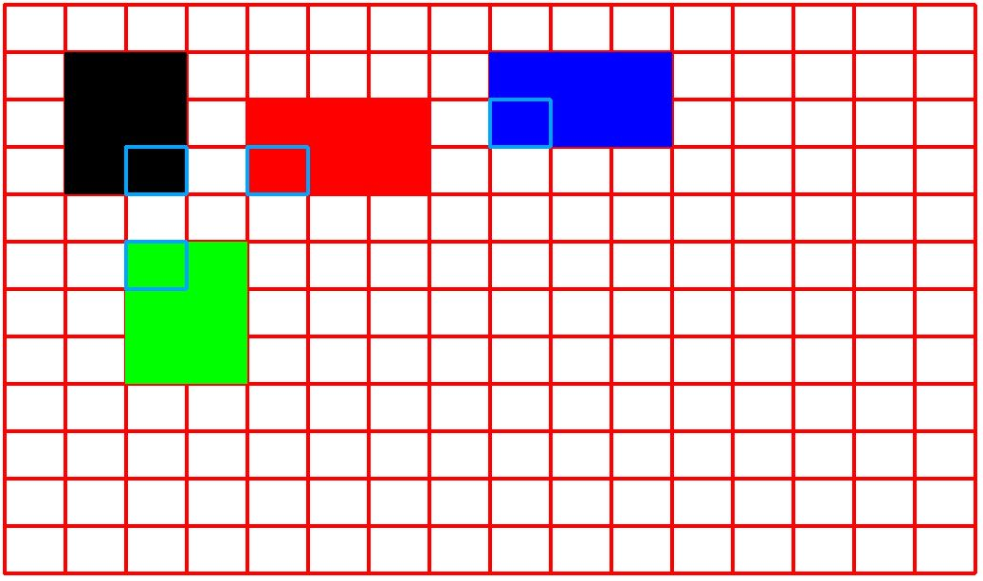
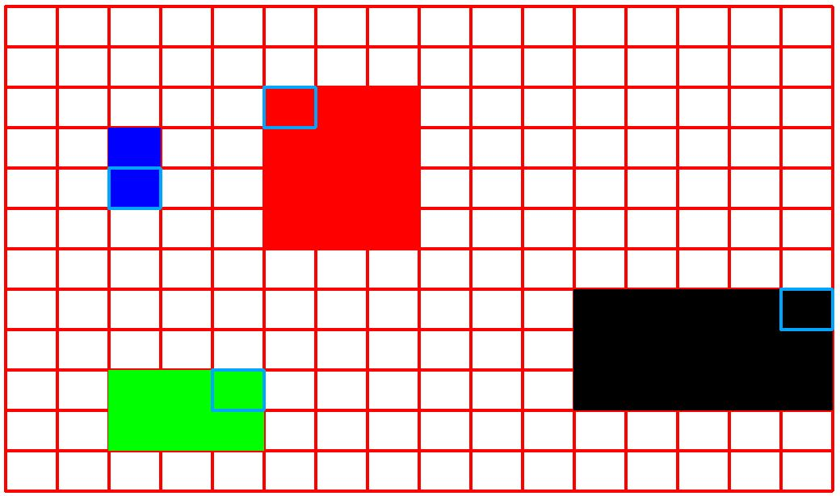
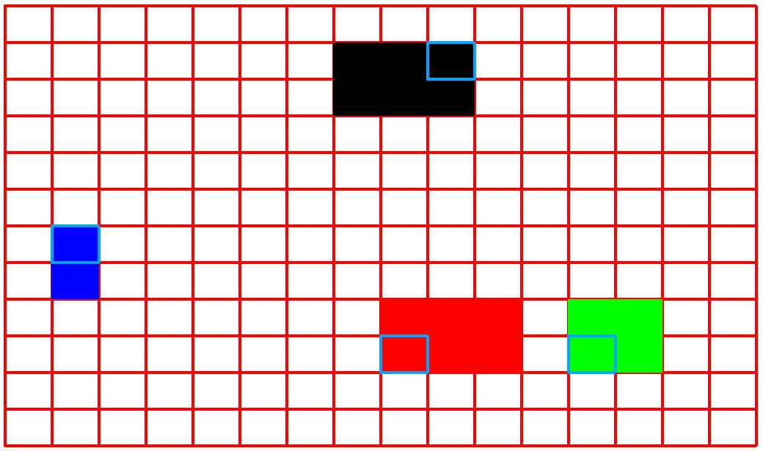
(A) Optimal Placement for Tall Box Test Case
(B) Optimal Placement for Pyramid Test Case
(C) Optimal Placement for Resized 3DBenchy Test Case

